Slide 1
How did the Germans feel?
Discuss with your tables how the Germans felt about the treaty of Versailles…..
Angry….. Explain why
How the Germans Felt?
Part 1: connect the learning

Slide 2
To develop skills of source analysis through making inferences
To identify and explain how different cartoons give us a different impression of the Treaty of Versailles
Part 2: learning outcomes / success criteria

Slide 3
Source Analysis; What can cartoons tell us?
What can you infer from the source about attitudes towards the Treaty of Versailles?
Part 3: share new information

Slide 4
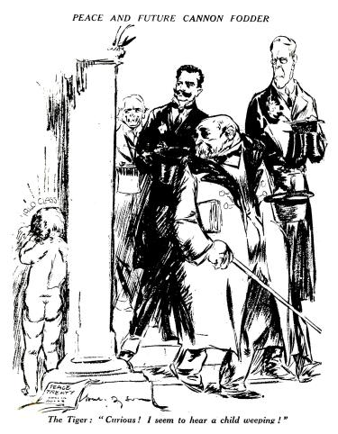
MAKING INFERENCES
Step 1:
In one colour, label WHAT you can see (e.g.)
Part 3: share new information

Slide 5
The caption says “Future cannon fodder”
The child is crying
Clemenceau says the child crying is “Curious”
The child is naked
Part 3: share new information

Slide 6
MAKING INFERENCES
Step 2:
In another colour, explain what you think the MEANING of these things are or what they symbolise.
Part 3: share new information

Slide 7
The caption says “Future cannon fodder”
The child is crying
This means that the child will grow up to be ‘cannon fodder’ (killed in war) in future
Because he will be of military age in 20 years and knows that the future will hold.
Clemenceau says the child crying is “Curious”
The child is naked
Clemenceau does not understand what the consequences of the Treaty will be.
This means that he is innocent, helpless and vulnerable.
Part 3: share new information

Slide 8
MAKING INFERENCES
Step 3:
Identify the Nature, Origin and Purpose (NOP) of the Cartoon.
Part 3: share new information

Slide 9
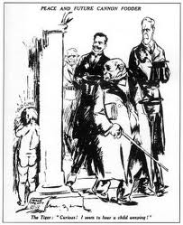
'Peace and future cannon fodder' - a cartoon by the Australian artist Will Dyson.
It appeared in the Daily Herald, a British newspaper on 17th May 1919.
Satirical cartoon
Part of the Commonwealth – on the same side as Britain.
Britain was part of the Big 3 and had helped to defeat Germany.
Few months after the Treaty was negotiated.
Part 3: share new information
Notes:
Pupils may need the word satirical to be explained again.

Slide 10
MAKING INFERENCES
Step 4:
Does the NOP affect how reliable what the cartoon tells us is?

Slide 11
'Peace and future cannon fodder' - a cartoon by the Australian artist Will Dyson.
It appeared in the Daily Herald, a British newspaper on 17th May 1919.
Satirical cartoon
Designed to make leaders look bad – making fun of them
Part of the Commonwealth – on the same side as Britain.
Could be biased against Germany
Britain was part of the Big 3 and had helped to defeat Germany.
Few months after the Treaty was negotiated.
Could be biased against Germany
Cartoon from same period, would most likely know a lot about the treaty and public opinion
Part 3: share new information
Notes:
Pupils may need the word satirical to be explained again.

Slide 12
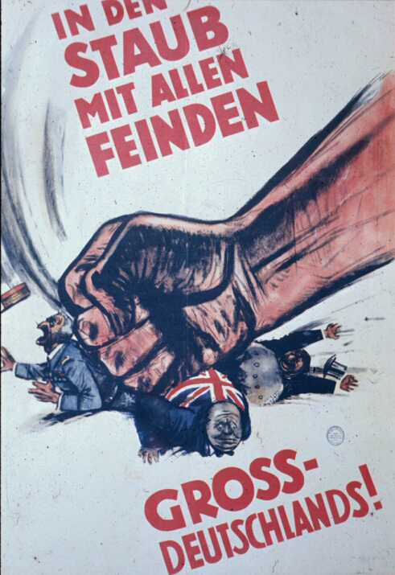
This poster was released in summer 1940.
The text translates as: “Smash the Enemies of Greater Germany!” A literal translation would be: “Into Dust with All Enemies of Greater Germany.”
This is a reference to Heinrich von Kleist’s The Prince of Homburg. In that play, a desperate Brandenburg, progenitor of Prussia, is saved from overwhelming threat from invading Swedes by the virtue of its campaigners, as well as its ruler. The final line of the play: “Into the dust with all enemies of Brandenburg.”
Author unknown.

Slide 13
MAKING INFERENCES
Step 5:
Tying it all together and answering the question.
Part 3: share new information

Slide 14
What can you infer from the source about attitudes towards the Treaty of Versailles?
I can infer from the source that…
The source implies that…
The source suggests that…
The nature of the denotes…
The origin of the source suggests…
The purpose of the source infers…
Part 3: share new information

Slide 15
2. This poster was released in summer 1940. The text translates as: “Smash the Enemies of Greater Germany!” A literal translation would be: “Into Dust with All Enemies of Greater Germany.”
This is a reference to Heinrich von Kleist’s The Prince of Homburg. In that play, a desperate Brandenburg, progenitor of Prussia, is saved from overwhelming threat from invading Swedes by the virtue of its campaigners, as well as its ruler. The final line of the play: “Into the dust with all enemies of Brandenburg.”
.

Slide 16
What can you infer from the source about attitudes towards the Treaty of Versailles?
Step 1: In one colour, label WHAT you can see.
Step 2: In another colour, explain what you think the MEANING of these things are or what they symbolise.
Step 3: Identify the Nature, Origin and Purpose (NOP) of the Cartoon.
Step 4: Does the NOP affect how reliable what the cartoon tells us is?
Step 5: Tying it all together and answering the question.
Part 3: share new information
Notes:
Give the pupils 1 of the 6 cartoons for them to answer the question about. If you wish pupils can choose their own. For lower ability groups you may like to select one to do together and then have them all write up the same cartoon.

Slide 17
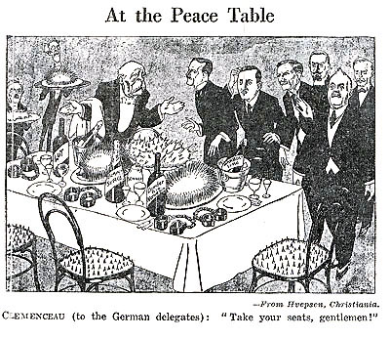
A British cartoon published in August 1919.
Part 4: challenge activity
Notes:
Pupils who have worked on this cartoon can feedback to the class as to what the cartoon means and what they have inferred from it.

Slide 18
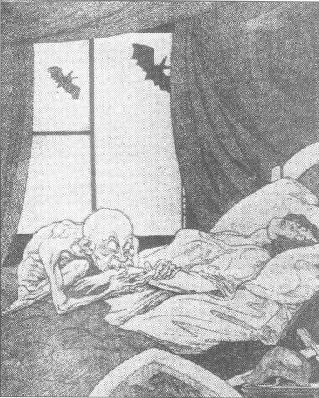
A cartoon from a German newspaper along side a news story explaining the outcome of the Paris Peace Conference.
Part 4: challenge activity
Notes:
Pupils who have worked on this cartoon can feedback to the class as to what the cartoon means and what they have inferred from it.

Slide 19
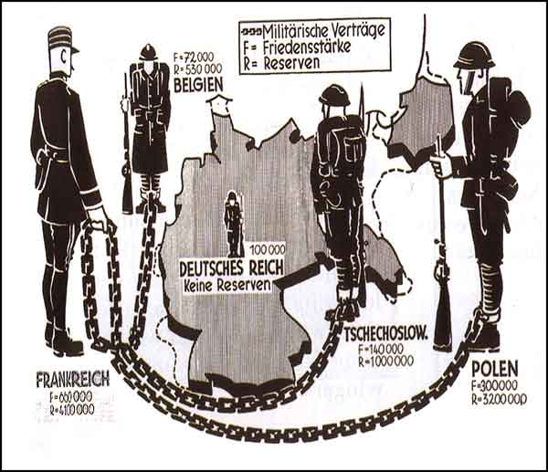
A cartoon from a German newspaper along side a news story explaining the Treaty’s terms on Germany’s Army.
Part 4: challenge activity
Notes:
Pupils who have worked on this cartoon can feedback to the class as to what the cartoon means and what they have inferred from it.

Slide 20
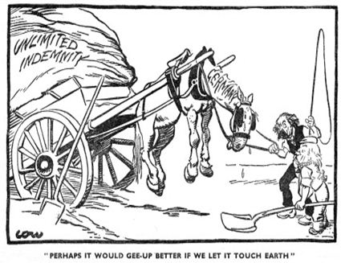
A British Cartoon about the peace treaty published in July 1919.
Part 4: challenge activity
Notes:
Pupils who have worked on this cartoon can feedback to the class as to what the cartoon means and what they have inferred from it.

Slide 21
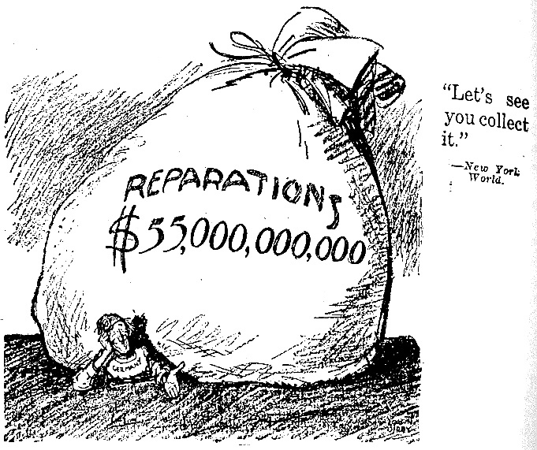
An American cartoon published in 1920.
Part 4: challenge activity
Notes:
Pupils who have worked on this cartoon can feedback to the class as to what the cartoon means and what they have inferred from it.

Slide 22
What can source A tell us about the German reaction to The Treaty of Versailles?
Use the source and your own knowledge to answer this question.
SOURCE A
A cartoon from a German newspaper called ‘Clemenceau the vampire’ along side a news story explaining the outcome of the Paris Peace Conference.
Part 5: demonstrate new understanding

Slide 23
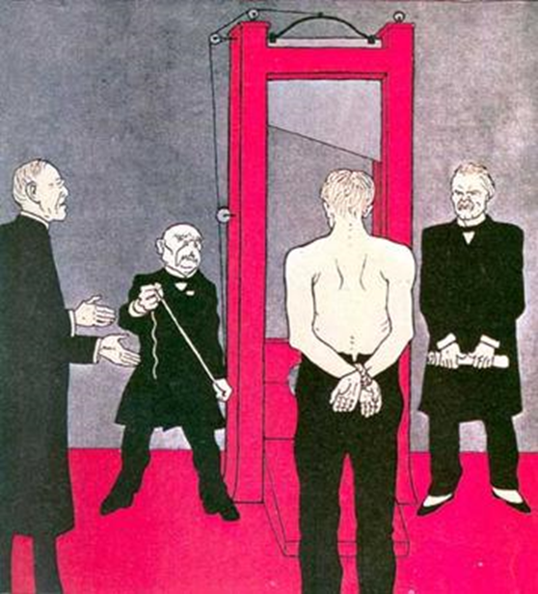
Part 6: review and reflect

